Slide 1
Card Sorting
February 15, 2016
Lauren Kett
Louise Whitaker
Pablo Obando
Chris Roy

Slide 2
Introduction
The team performed a non-directive hasty (without context) card sort. The product researched was the UM Interactive Media website (interactive.miami.edu) a specific website for the School of Communication part of the University of Miami located in Coral Gables, Florida.
The team used Xsort, a software program, designed to digitally organize sections and categories of our product tested. We had 16 participants within four age categories perform a card sort without introduction.
Here are our results.
Notes:
Lauren

Slide 3
Methods - Equipment
Laptop - To conduct card sorts and compile the report
XSort - To conduct card sorting
Excel - To compile the distance matrixes
Google Forms - For the demographics questionnaire
PowerPoint - To compile the report
Pen and paper - To take notes while participant completed the card sort
Phone - To take photos
Notes:
Pablo

Slide 4
Methods - Procedure
Open XSort software and start a session
Have user fill out the profile (gender and age) on the first page of the session mode
Give instructions and explain purpose to participant:
“We want to see what groupings of these cards make sense to you. Once you have grouped the cards, you will name each of the groupings. Sort the items as quickly as possible.”
In session mode in XSort, show the participant how to group items and make labels for the items they have grouped
Take notes as participant “thinks out loud” and processes groupings
Ask participant to create hierarchy of the groups, Have them label groups: critical, important, unimportant or topics not wanted on site
Take photos of finished card sorts
Record the time it took the participant to complete the card sort
Give participant demographic questionnaire
Thank participants for their time
Notes:
Louise

Slide 5
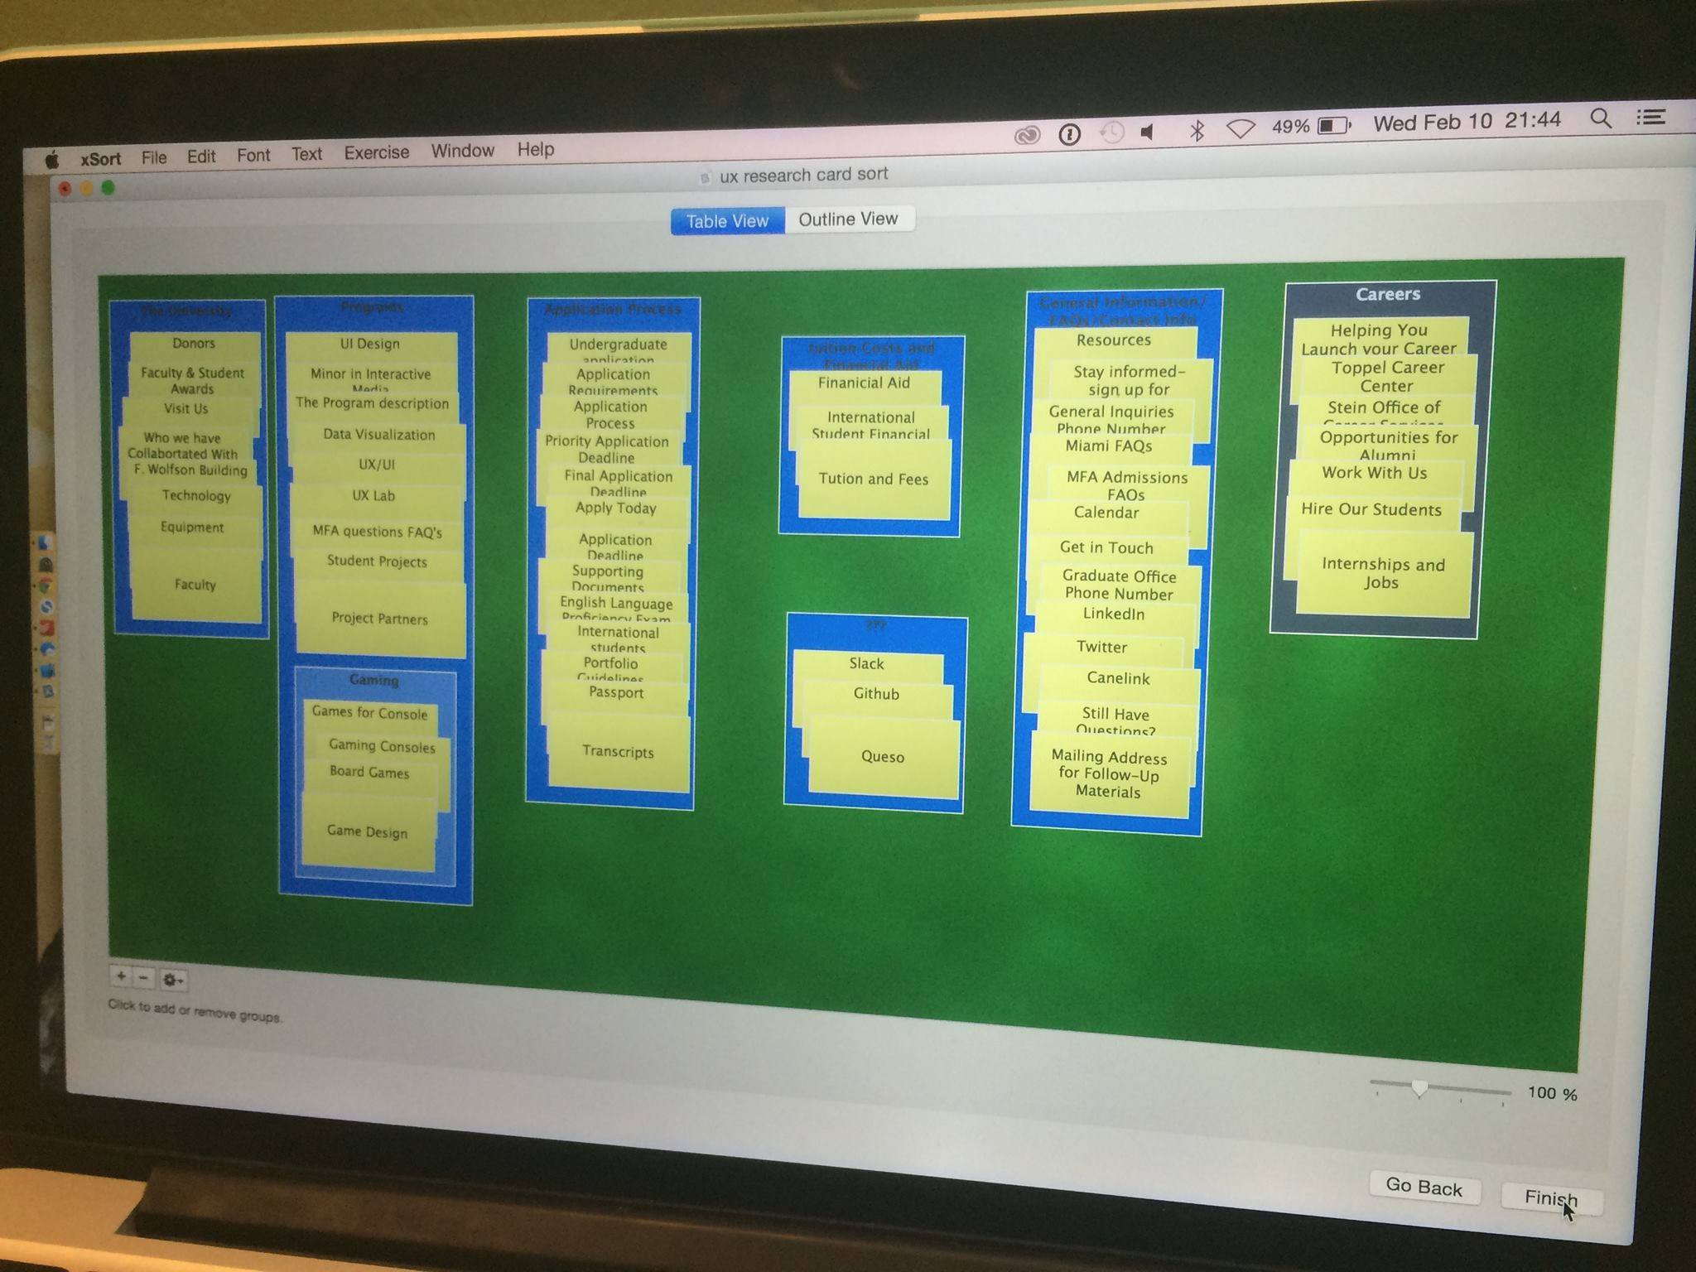
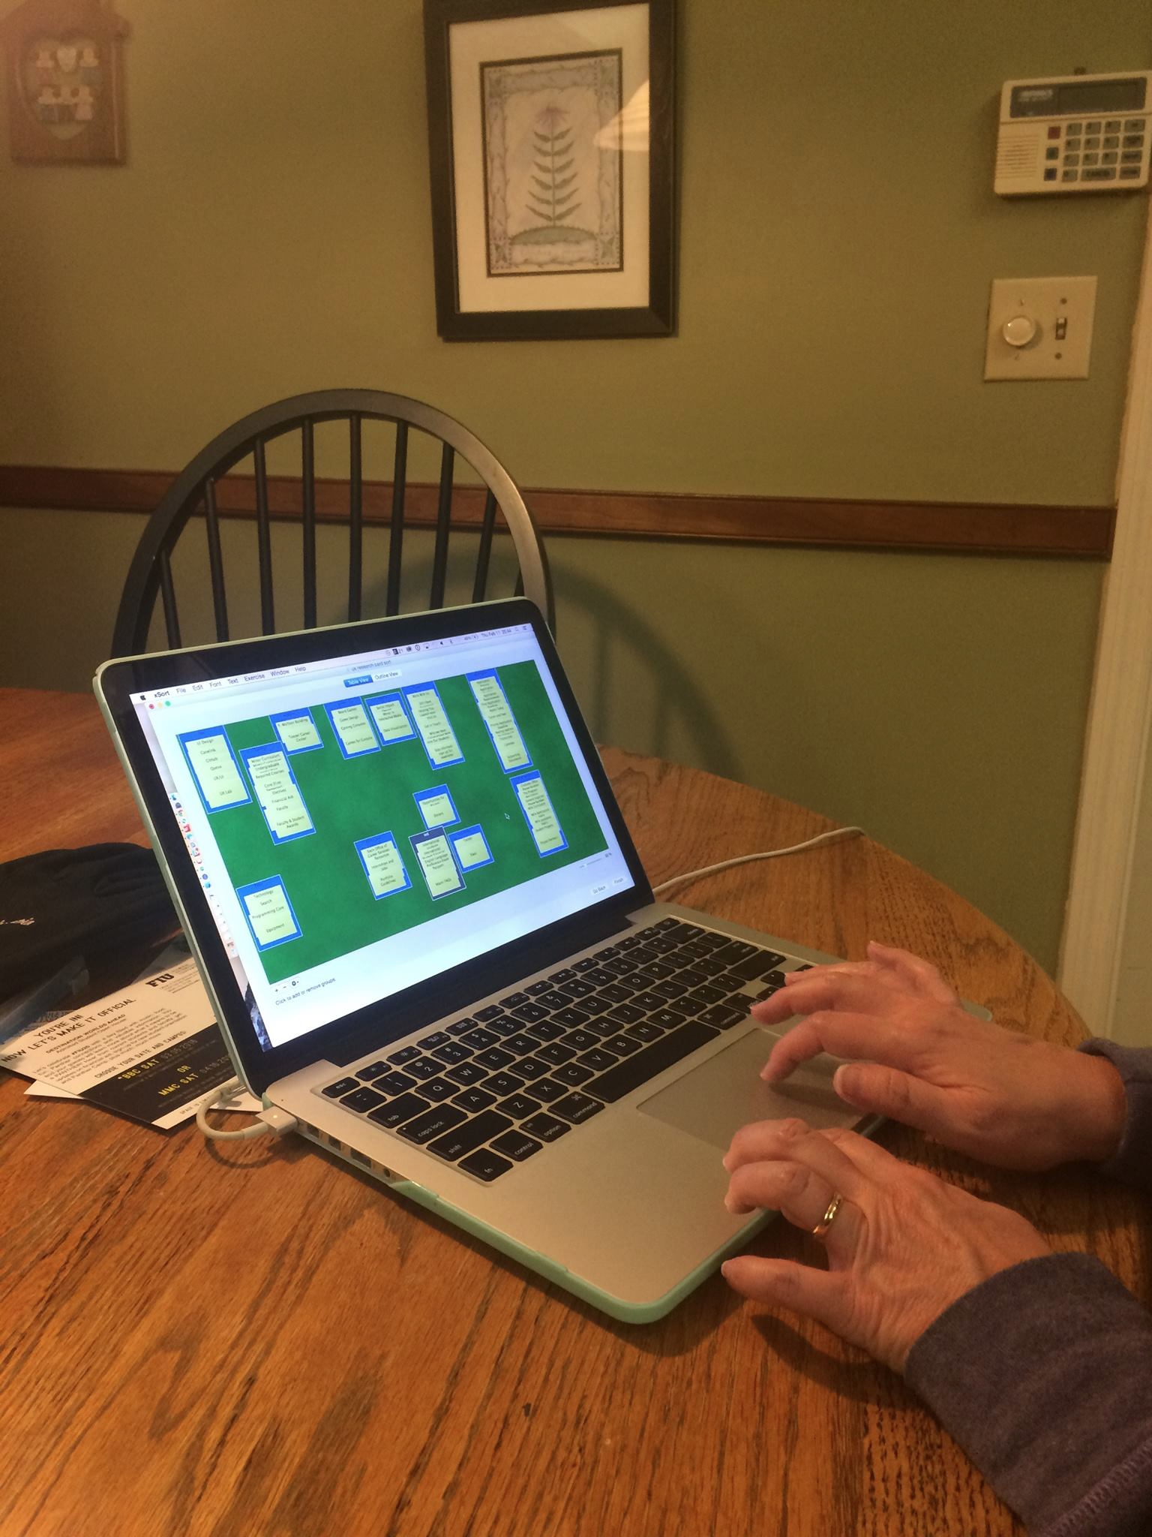
Methods - Procedure

Slide 6
Methods - Item List
Application Requirements
Application Deadline
Application Process
International students
Portfolio Guidelines
Undergraduate application
Minor in Interactive Media
Supporting Documents
Transcripts
English Language Proficiency Exam Results
Passport
International Student Financial Statement
Financial Aid
Tuition and Fees
Priority Application Deadline
Final Application Deadline
MFA Curriculum
Minor Curriculum
Social Impact Design
Search
Core (First Semester)
Required Courses
Electives
Programming Core
F. Wolfson Building
UX Lab
Equipment
Technology
Board Games
Games for Consoles
Gaming Consoles
The Program description
Faculty
Faculty & Student Awards
Internships and Jobs
Helping You Launch your Career
Stein Office of Career Services and Internships
Toppel Career Center
Hire Our Students
Opportunities for Alumni
Work With Us
Who we have Collaborated With
Project Partners
Donors
Still Have Questions?
MFA questions FAQ's
MFA Admissions FAQs
Miami FAQs
Get in Touch
Mailing Address for Follow-Up Materials
General Inquiries Phone Number
Graduate Office Phone Number
Game Design
UI Design
UX/UI
Data Visualization
Student Projects
Apply Today
Resources
Calendar
Queso
Canelink
Slack
Github
Twitter
LinkedIn
Stay Informed- sign up for newsletter
Visit Us
Notes:
Chris

Slide 7
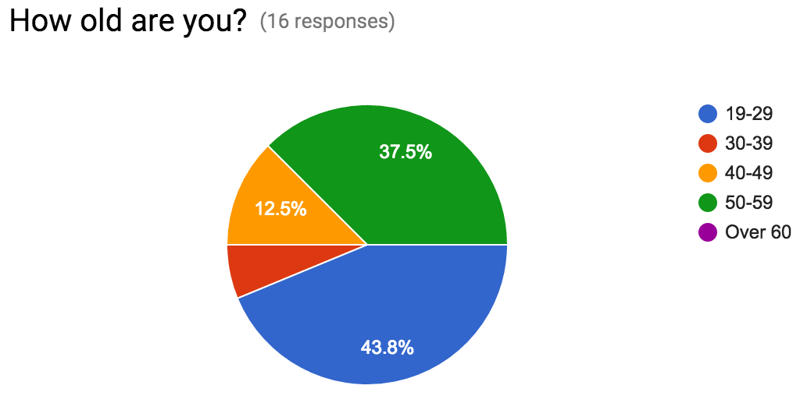
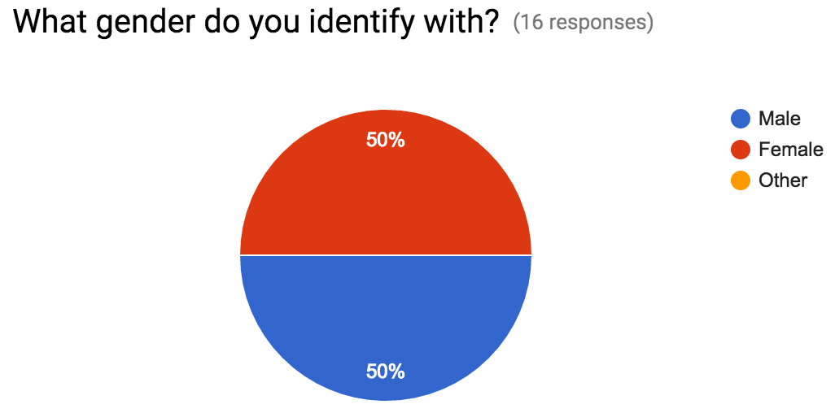
Methods - Participants
Age:
19-29: 7 participants
30-39: 1 participant
40-49: 2 participants
50-59: 6 participants
Over 60: no participants
Gender:
Male: 8 participants
Female: 8 participants
Other: no participants
Notes:
Lauren

Slide 8
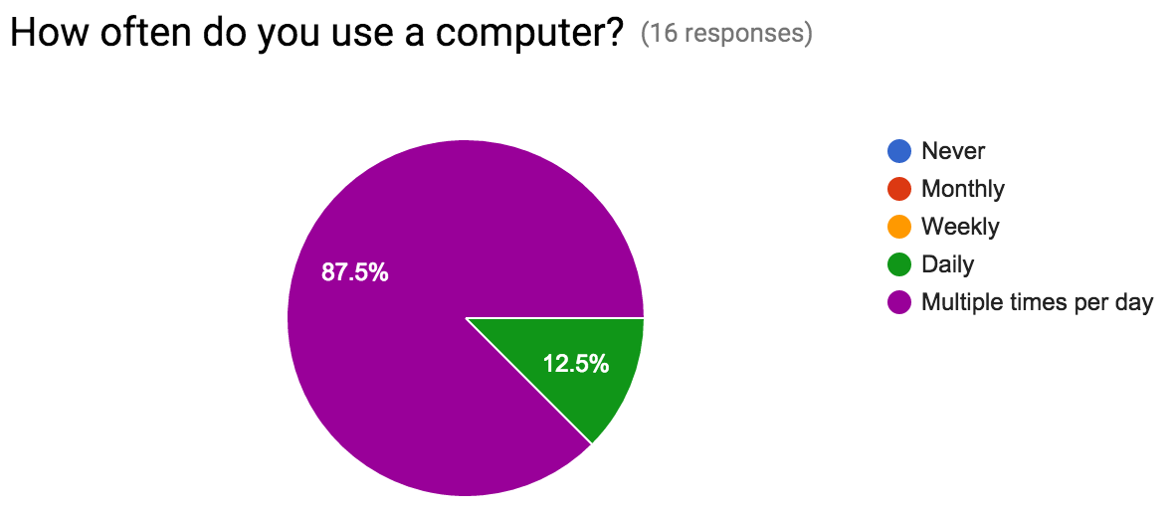
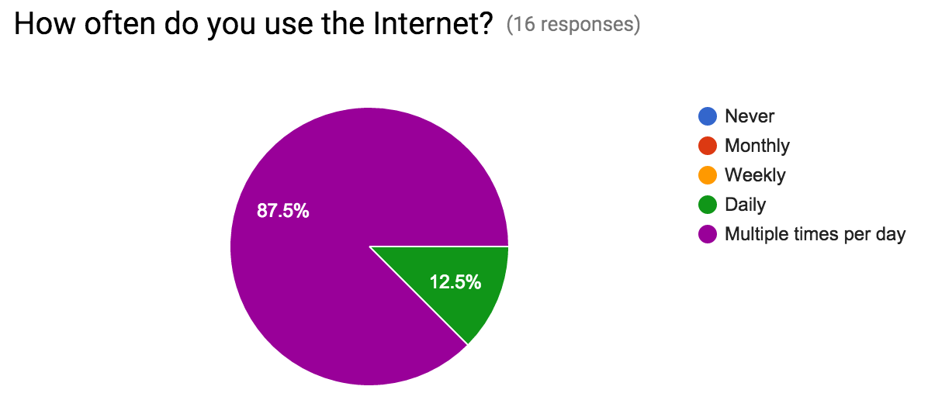
Methods - Participants
Computer Usage:
Never: no participants
Monthly: no participants
Weekly: no participants
Daily: 2 participants
Multiple times per day: 14 participants
Internet Usage:
Never: no participants
Monthly: no participants
Weekly: no participants
Daily: 2 participants
Multiple times per day: 14 participants
Notes:
Lauren

Slide 9
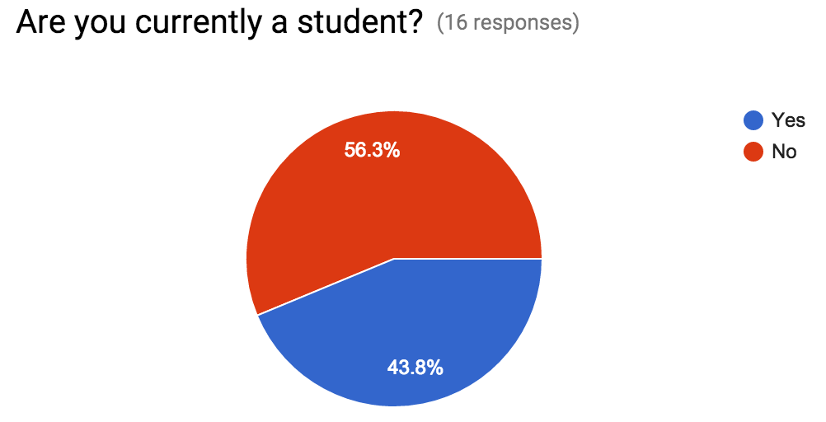
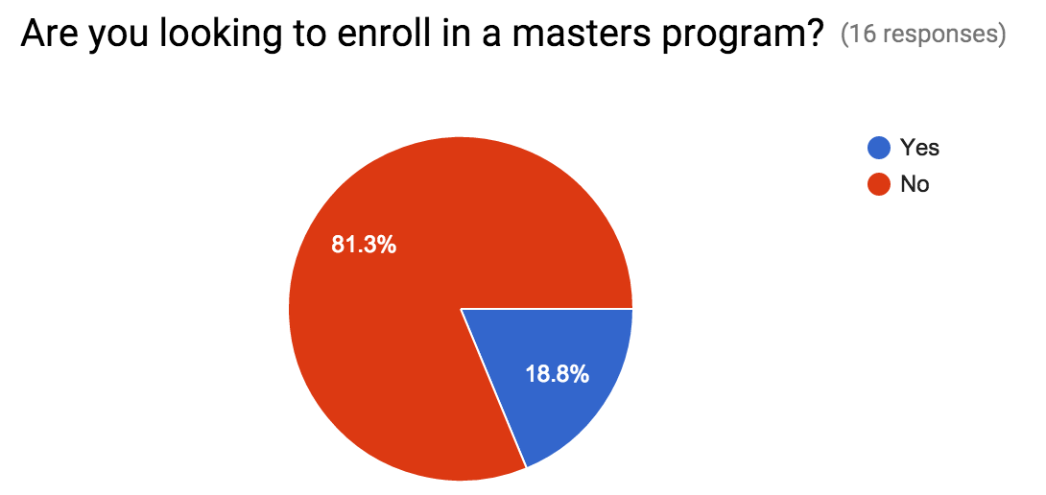
Methods - Participants
Currently a student:
Yes: 7 participants
No: 9 participants
Looking for a Master’s Program:
Yes: 3 participants
No: 13 participants
Notes:
Lauren

Slide 10
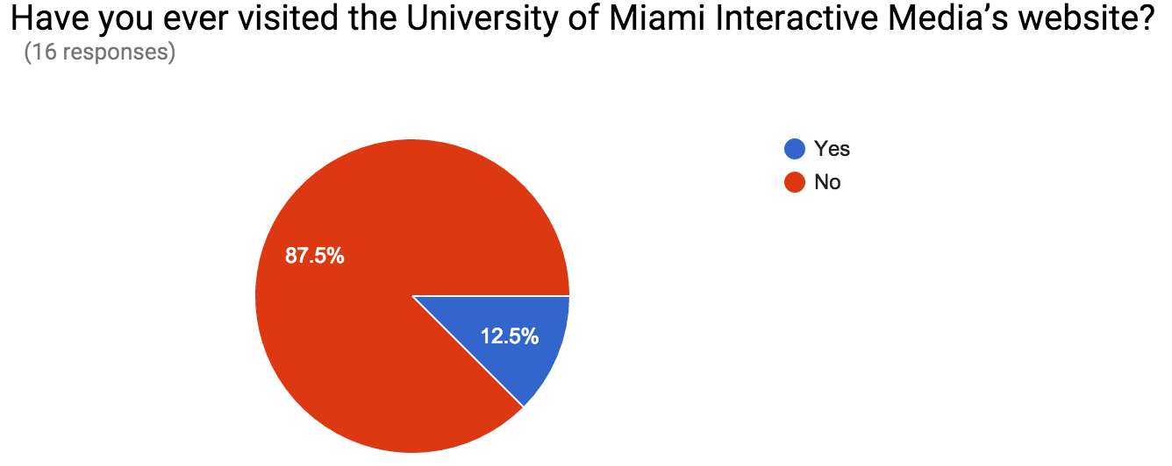
Methods - Participants
Visited UM Interactive Site:
Yes: 2 participants
No: 14 participants
Notes:
Lauren

Slide 11
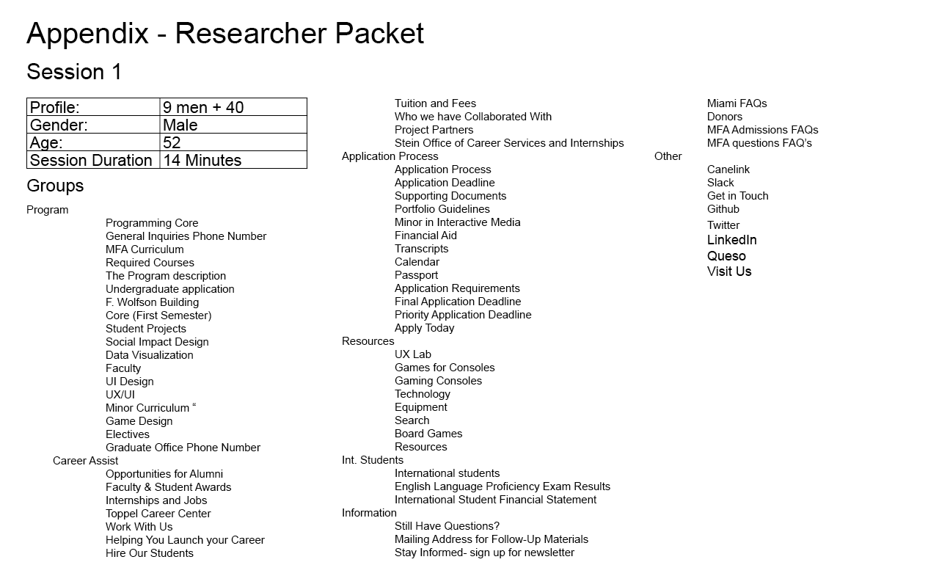
Data & Analysis - Category Items and Labels by Participant
(See Appendix for complete list)
Notes:
Louise

Slide 12
Data & Analysis - Prioritized categories
Hierarchy: women + 40
Participant 1
Critical
college
grad school
application
Important
tech
career svc
intl [international]
alumni
media
Unimportant
slogan
game
soc media [social media]
idk[I don’t know]
location
Participant 2
Critical
degree type
Important
apply
career path
instruction
equipment
Unimportant
other stuff
? “(not sure what this stuff is)”
Notes:
Pablo

Slide 13
Data & Analysis - Prioritized categories
Hierarchy: women + 40
Participant 3
Critical
application
Important
international resources
project results
campus resources
MFA
social media
Unimportant
yo no se [unknown material]
student curriculum
alumni info
Participant 4
Critical
college finances
grad school
college application
Important
internships and jobs
international students
faculty and alumni
communication options
Unimportant
programming/ computer terms I don’t know
games
Notes:
Pablo

Slide 14
Data & Analysis - Prioritized categories
Hierarchy: men + 40
Participant 5
Critical:
MFA subspecialty
Contacts for future employment
Important
Technology
End of product of programming
General University Information
Unimportant
Left overs
General info stuff [general information]
Participant 6
Critical
application process
Important
program
career assist
resources
international students
information
Unimportant
other
Notes:
Pablo

Slide 15
Data & Analysis - Prioritized categories
Hierarchy: men + 40
Participant 7
Critical
apply
courses
Important
MFA info
career ctr
faculty
financial aid
international
UX
Unimportant
other
Participant 8
Critical
application process
major/minor information
Important
program description
faculty
job opportunities
resources
Notes:
Pablo

Slide 16
Data & Analysis - Prioritized categories
Hierarchy: female - 40
Participant 9
Critical:
Relevant to International Students
Relevant to Applying Students
Important:
Programs and Curriculum
Website Resources
Career Resources
Unimportant:
Locations on Campus
Unknown
Participant 10
Critical:
Apps
Programs
Career/Higher Ed Prep
International
Important:
Social Media
Tuition
Location
Unimportant:
Gaming
Food
Notes:
Pablo

Slide 17
Data & Analysis - Prioritized categories
Hierarchy: female - 40
Participant 11
Critical:
Programs
Admissions
International Students
Important:
Career Services
Financials
Alumni and Advancement
Faculty
Project Management
Unimportant:
Social Media
Technology
Gaming
Misc
Participant 12
Critical:
Apps
Programs
Career/Higher Ed Prep
International
Important:
Social Media
Tuition
Location
Unimportant:
Gaming
Food
Notes:
Pablo

Slide 18
Data & Analysis - Prioritized categories
Hierarchy: men - 40
Participant 13
Critical
apply
courses
Important
MFA info
career ctr
faculty
financial aid
international
UX
Unimportant
other
Participant 14
Critical
application process
major/minor information
Important
program description
faculty
job opportunities
resources
Notes:
Pablo

Slide 19
Data & Analysis - Prioritized categories
Hierarchy: men - 40
Participant 15
Critical
Application Information
Technology and Media
Important
Alumni and Career
Program Related
International
Unimportant
Partners
Participant 16
Critical
Application & Documents
Minors/Majors Programs
Interactive Media Programs
About Us
Important
Courses
Career Services
FAQs
International Students
Unimportant
Student Work
Stay Connected
Notes:
Pablo

Slide 20

Data Analysis - Distance Matrices by Participants
1 Woman + 40
(See appendix for all other participants)
Notes:
Chris

Slide 21
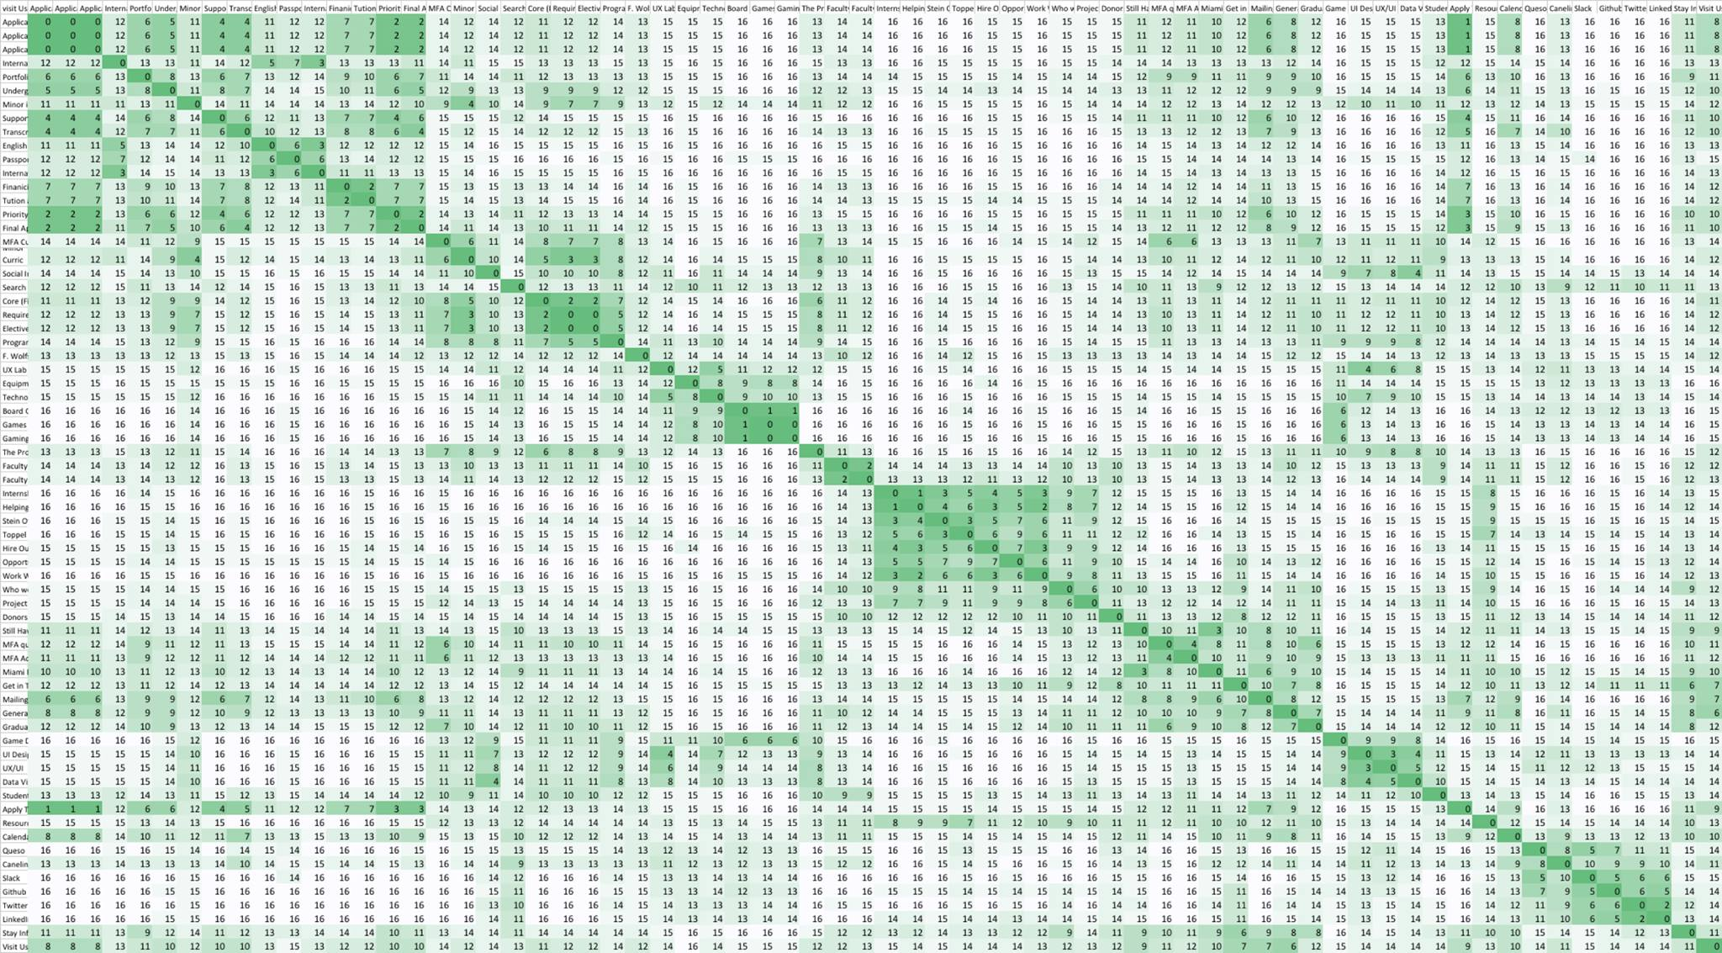
Data Analysis - Distance Matrices Across Participants
Notes:
Chris

Slide 22
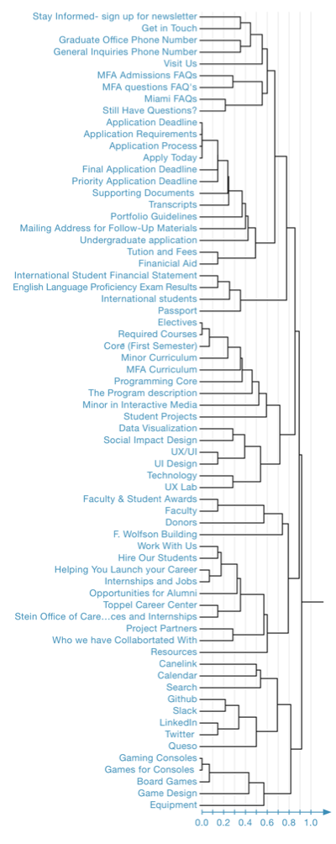
Data Analysis - Cluster Tree
Average linkage clustering
Notes:
Lauren

Slide 23
Data Analysis - Participant Card Sorting Data
Card sorting sessions: 16
Average age of participants: 38.5
Gender distribution of participants:
8 males
8 females
Groups made by participants:
minimum: 6
average: 8.5
maximum: 13
Duration by age/gender group:
Average Duration: 17 minutes, 2 seconds
Male over 40-years-old: 16 minutes
Male under 40-years-old: 11 minutes, 30 seconds
Female over 40-years-old: 21 minutes, 45 seconds
Female under 40-years-old : 18 minutes, 54 seconds
Notes:
Louise

Slide 24
Data Analysis - Findings
Confusion in naming for several cards, specifically:
Queso
Passport
Github
Canelink
Slack
One participant thought of items as literal objects, in which he placed calendar, passport, and gaming console into household items, possibly due to lack of context. Another participant grouped consoles and games together and titled it “Things used in class” because they wanted all the categories to be related to school
11 out of 16 participants created an international group that encompassed all of the international information (ie. International Students, English Language Proficiency Exam Results, International Student Financial Statement, some added passport to this group too)
All the participants created a grouping named application or admissions was critical or important and included the following:
Application Deadline
Application Requirements
Application Process
Notes:
Pablo

Slide 25
Data Analysis - Findings
Information about the school
resources and phone numbers together
All participants wanted to know what their organizing this for which distressed several participants
“It’s confusing grouping these things together. some do make sense together, but i'm not sure what's meant by each title of the thing”
All 16 participants put game consoles and games for consoles together.
Based on the distance matrix, ten participants out of 16 placed Game Design with board games.
only one participants did not put Board Games with Gaming Consoles and Games for Consoles.
Use of MFA without introducing acronym caused confusion amongst 4 out of 16
“media fine arts”, “master of fine… something”
Two females under 40 and three women over 40-years-old didn’t know the User Experience and User Interface (UX/UI) acronyms
Only 2 of the 16 participants reevaluated their categorization organization at the end of their sort before finishing. Both participants that edited under 40-years-old
FAQs were split up in 3 out of 4 participants lists into other categories
The two MFA FAQ’s were grouped together by 12 out of 16
Miami FAQ was grouped with MFA Questions by 8 participants, but 10 participants did not group the Miami FAQ with MFA Admissions FAQ
Notes:
Chris

Slide 26
Data Analysis - Findings
Distance matrix findings
Everyone put electives and requirements in the same category
15 participants put helping launching careers and internships and jobs together
Work with us and launch career was matched with 14 participants
Twitter and linkedIn were matched by 14 participants
Application deadline priority and final were matched by 14 participants with other application sections
Apply today was matched with application by 15 of the 16 participants
Half of the participants grouped the following cards together:
portfolio and undergraduate application
transcripts with financial aid
transcripts with tuition
general inquiries with application
Only 9 participants put general inquires phone number and graduate office phone number together
4 out of 4 of females under 40 thought the calendar was directly related to the application process to help understand the application deadlines
8 out of 16 participants put calendar with admission information
7 of 16 participants recognized the Wolfson building as a building on campus
Miami FAQ
There was insufficient information as to whether this card referenced the “city or university?”
Notes:
Lauren

Slide 27
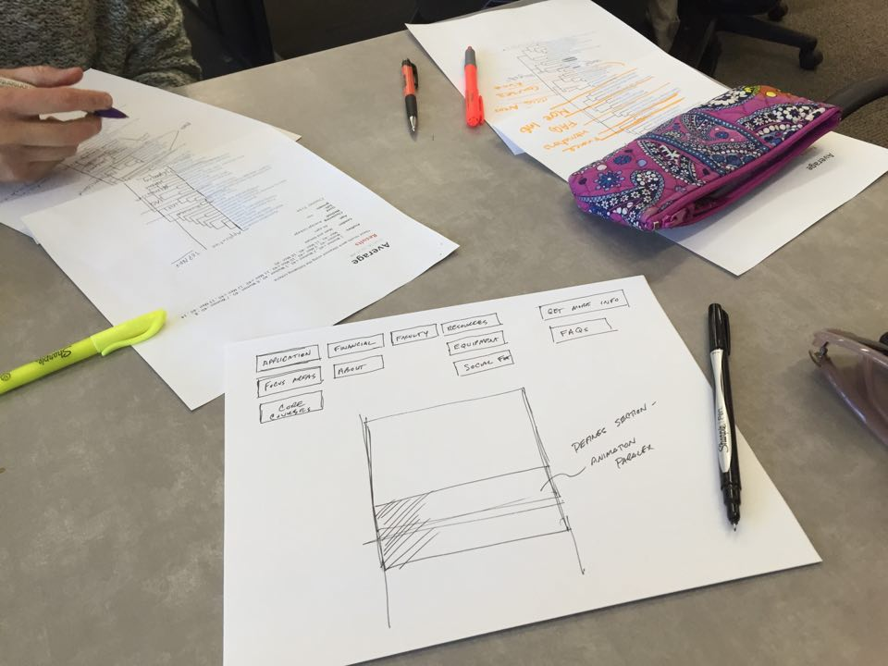
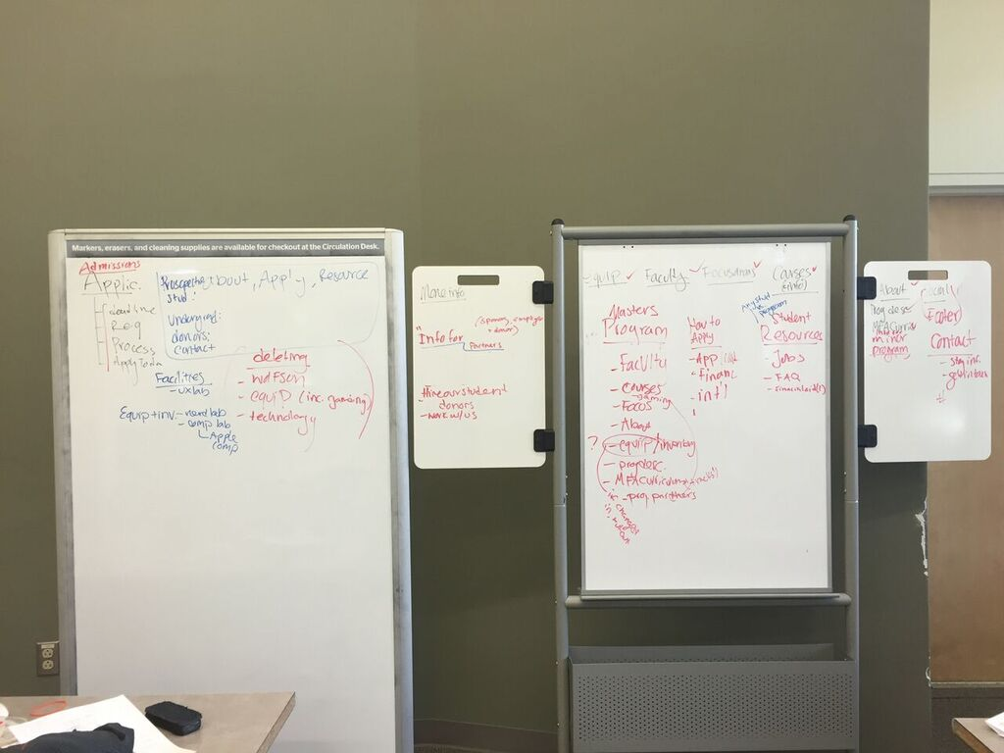
Data Analysis - Findings

Slide 28
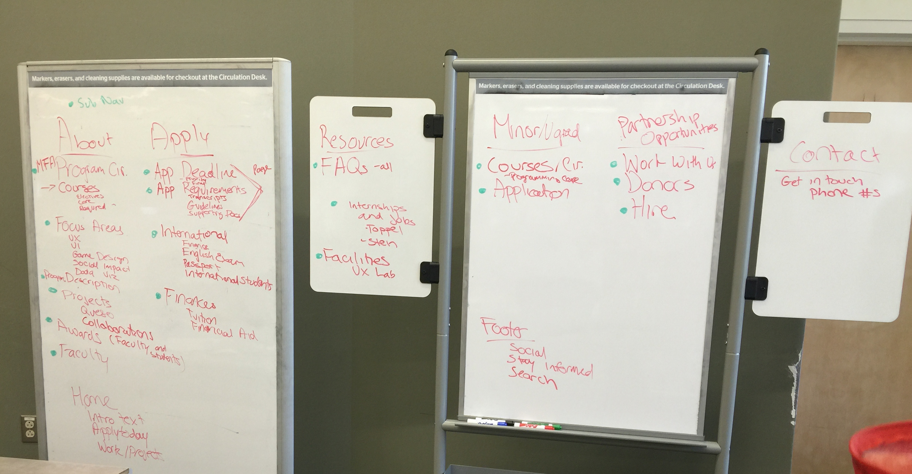
Data Analysis - Findings

Slide 29
Recommendations
We defined the audience using this website and found the main categories were:
MFA applicants
Undergraduate minor applicant
Potential donors, sponsors, and employers
Wanted to create very broad categories for the main navigation that were all encompassing, but descriptive
About
Apply
Resources
Minor/undergrad
Partnership opportunities
Contact and footer
Homepage
Footer
Notes:
Louise

Slide 30
Recommendations
Removed categories that were repeated with different titles or added value to prospective students, donors, or employers
Hire our students and opportunities for alumni
Lead to the same link, so we removed Opportunities for alumni because the titles were misleading
Equipment
Just inventory list, no value for applicants
Technology, gaming consoles, games for consoles and board games were all a part of equipment list.
If it was changed to showcase use, value and cool factor, then it would be kept
Project partners
Synonymous with partnership opportunities
Non-value added title to too many sub navigational elements
Canelink
not relevant to target audience. Only useful for current students
Calendar
The information the current calendar includes is not relevant to target audience. Only useful for current students
Helping launch your career
confusing name and redundant with internships and jobs subcategory of resources
Wolfson building
not relevant to target audience. Only useful for current students
Notes:
Louise

Slide 31
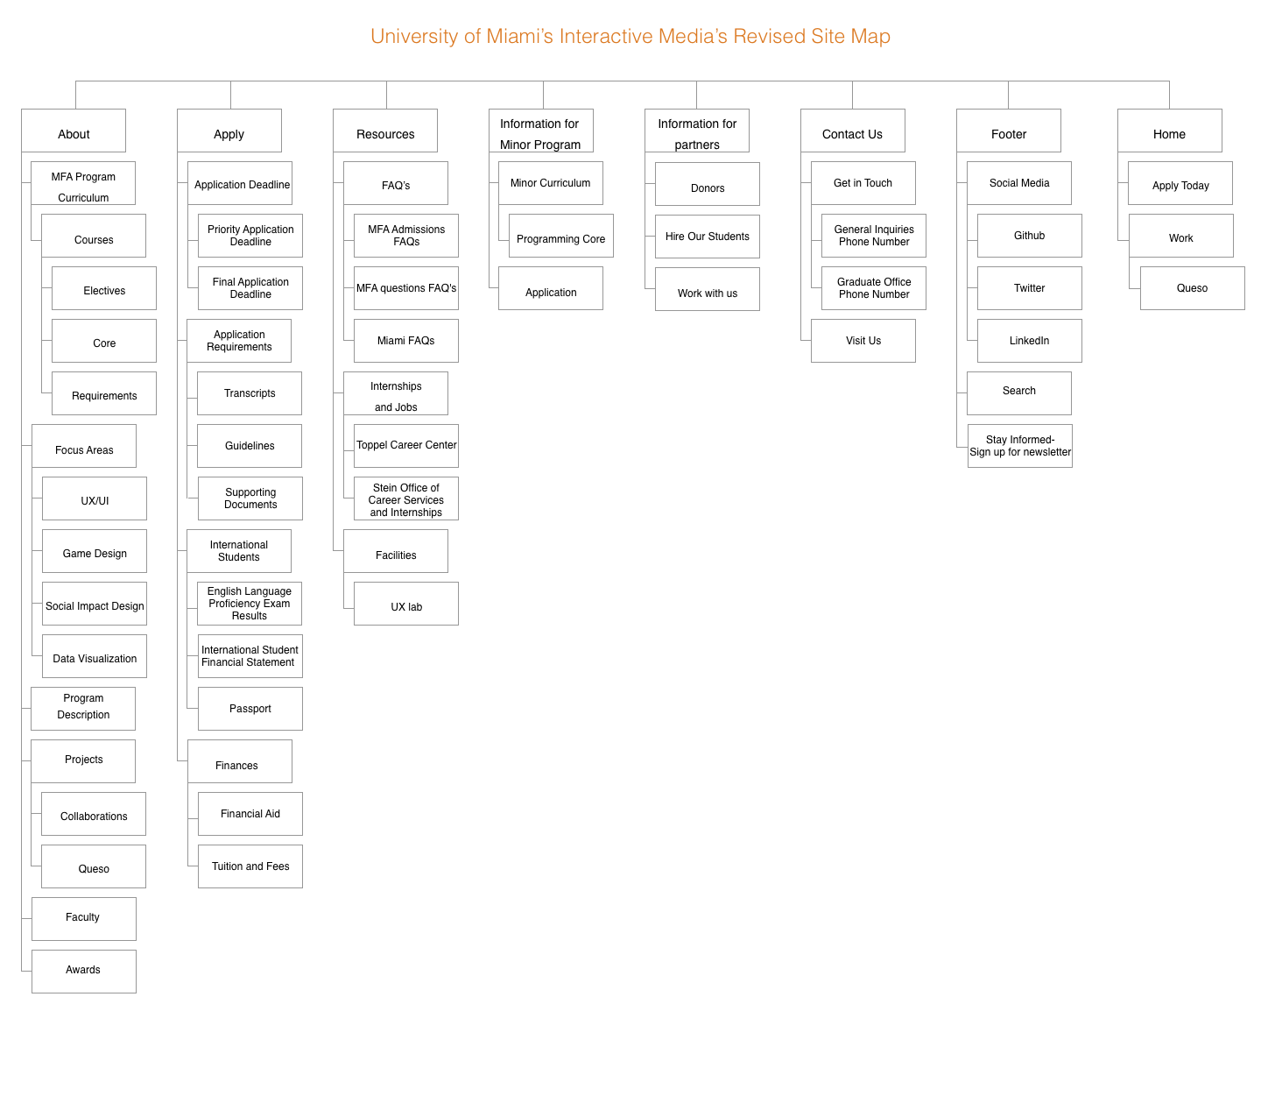

Slide 32
Appendix

Slide 33
Content
Demographic Survey
Procedure
Cluster Trees
Results by Session
Distance Matrix By Participant
Notes for Each Session

Slide 34
Appendix – Demographic Survey * Required
1. How old are you? *
19-29
30-39
40-49
50-59
Over 60
2. What gender do you identify with? *
Male
Female
Other : _______________
3. How often do you use a computer? *
Never
Monthly
Weekly
Daily
Multiple times per day
4. How often do you use the Internet? *
Never
Monthly
Weekly
Daily
Multiple times per day
5. Are you currently a student? *
Yes
No
6. Are you looking to enroll in a masters program? *
Yes
No
7. Have you ever visited the University of Miami Interactive Media’s website?*
Yes
No

Slide 35
Appendix - Procedure
1) Open XSort software and start a session
2) Have user fill out the profile (gender and age) on the first page of the session mode. Need to make sure we get these categories:
i) 4 females over or = 40-yrs-old
ii) 4 females under 40-yrs-old
iii) 4 males over or = 40-yrs-old
iv) 4 males under 40-yrs-old
3) Give instructions and explain purpose to participant:
a) “We want to see what groupings of these cards make sense to you. Once you have grouped the cards, you will name each of the groupings. Sort the items as quickly as possible.”
b) In session mode in XSort, show the participant how to group items and make labels for the items they have grouped
c) Make sure not to give the participant any background information on the topic
4) Take notes as participant “thinks out loud” and processes groupings
5) Ask participant to create hierarchy of the groups; have them label groups: critical, important, unimportant or topics not wanted on site
6) Take photos of finished card sorts
7) Record the time it took the participant to complete the card sort
8) Give participant demographic questionnaire
9) Thank participants for their time

Slide 36
Appendix - Cluster Trees
Cluster Tree(for complete and single)
The maximum distance between elements of each cluster (also called complete-linkage clustering)
The minimum distance between elements of each cluster (also called single-linkage clustering)
The mean distance between elements of each cluster (also called average linkage clustering, used e.g. in UPGMA)

Slide 37
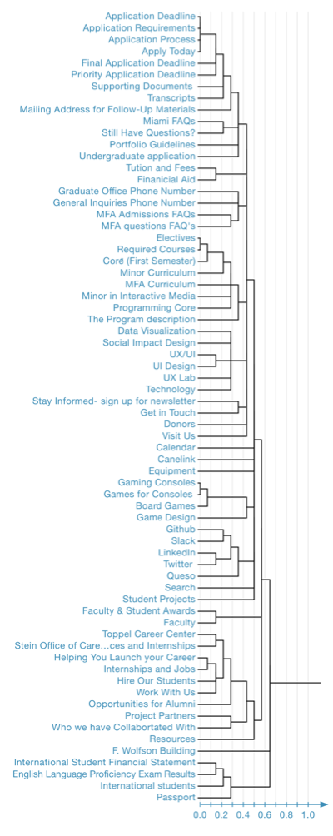
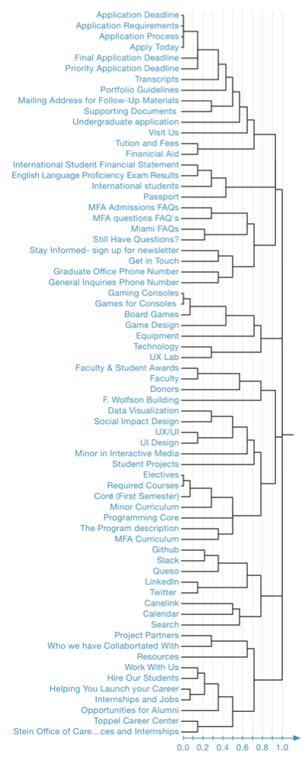
Appendix - Cluster Trees cont.
Single-linkage clustering
Average linkage clustering
Complete-linkage clustering

Slide 38
Appendix – Session Results

Slide 39
Appendix - Session 1
Notes:
Louise

Slide 40
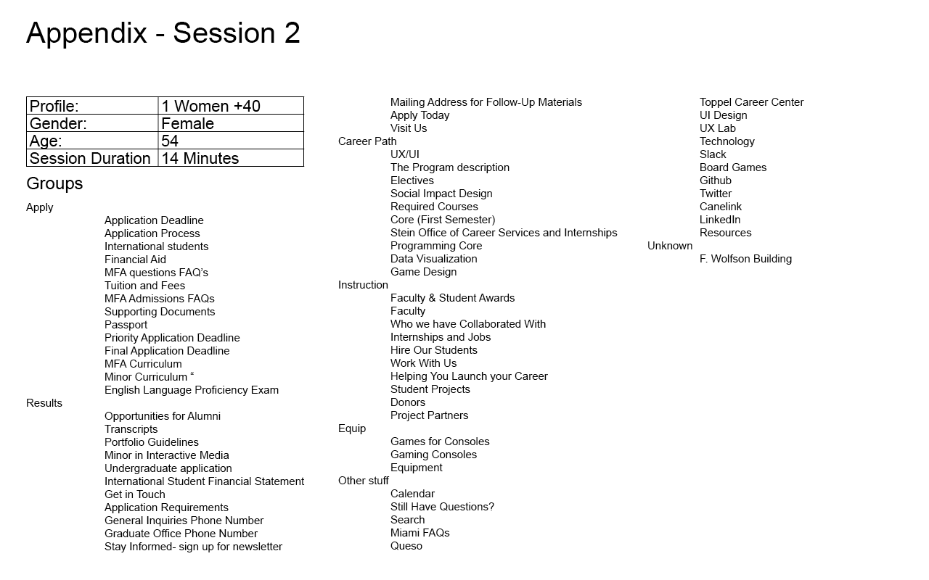

Slide 41
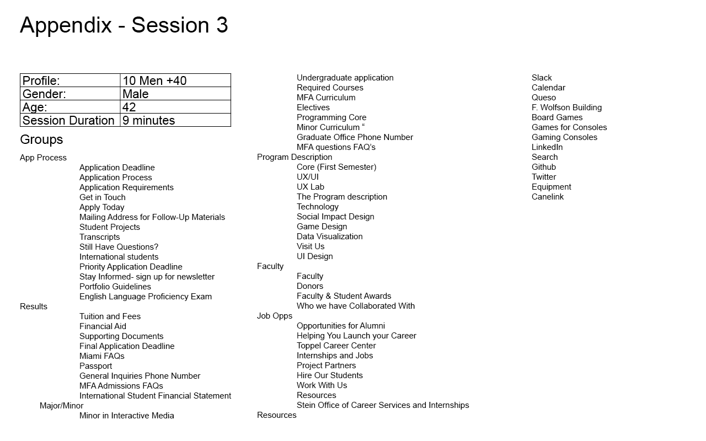

Slide 42
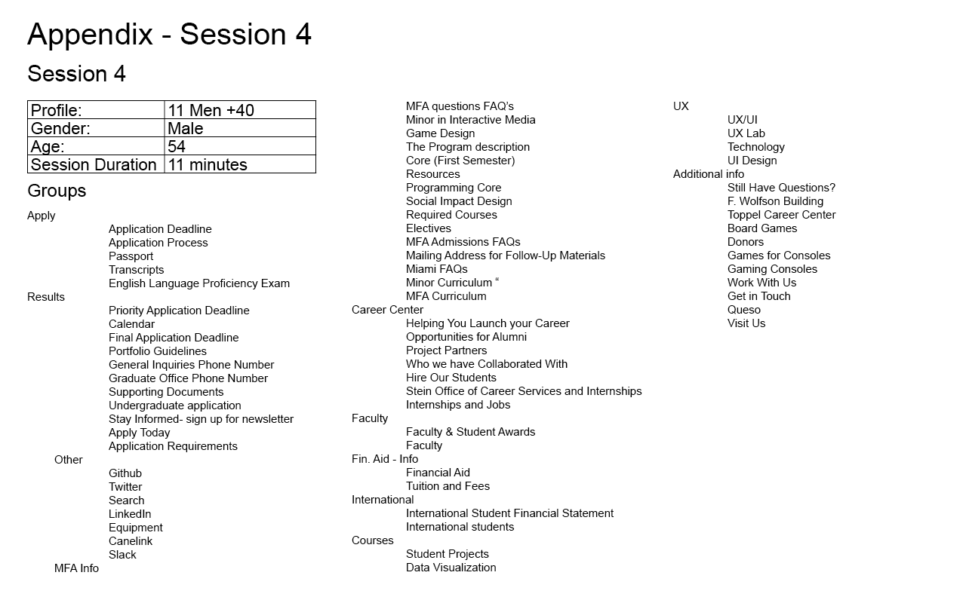

Slide 43
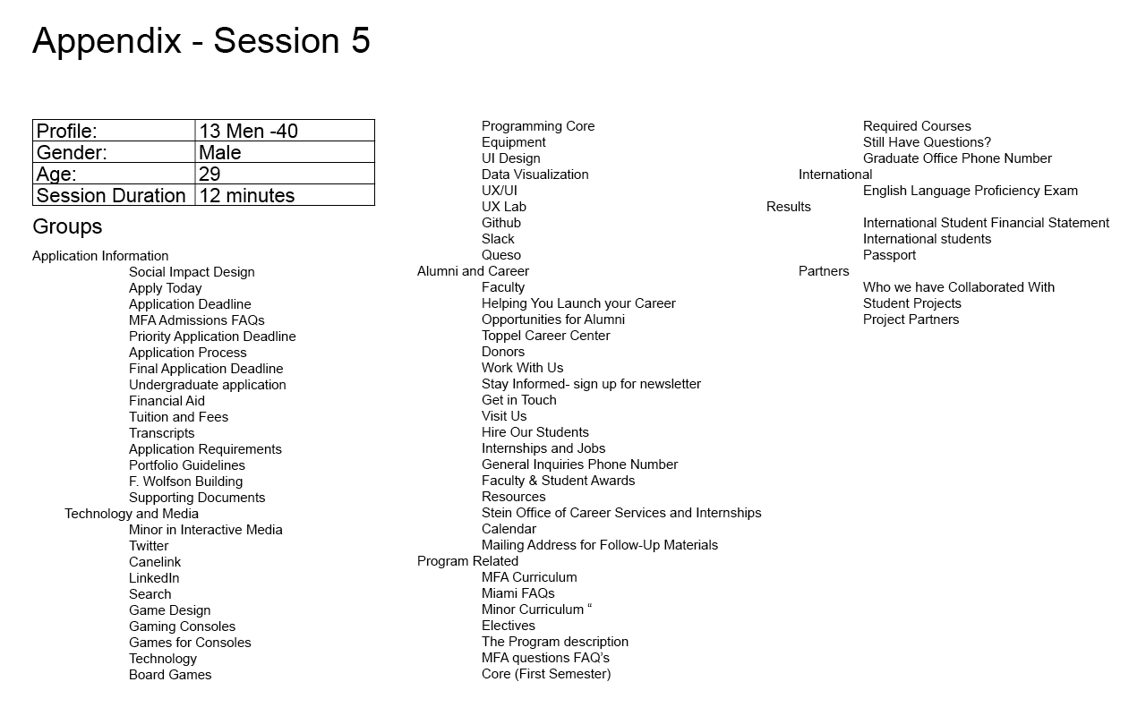

Slide 44
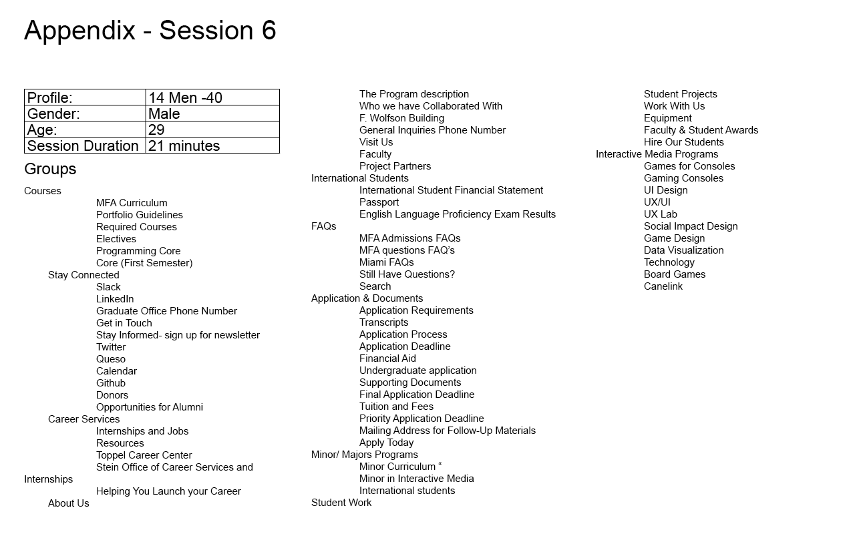

Slide 45
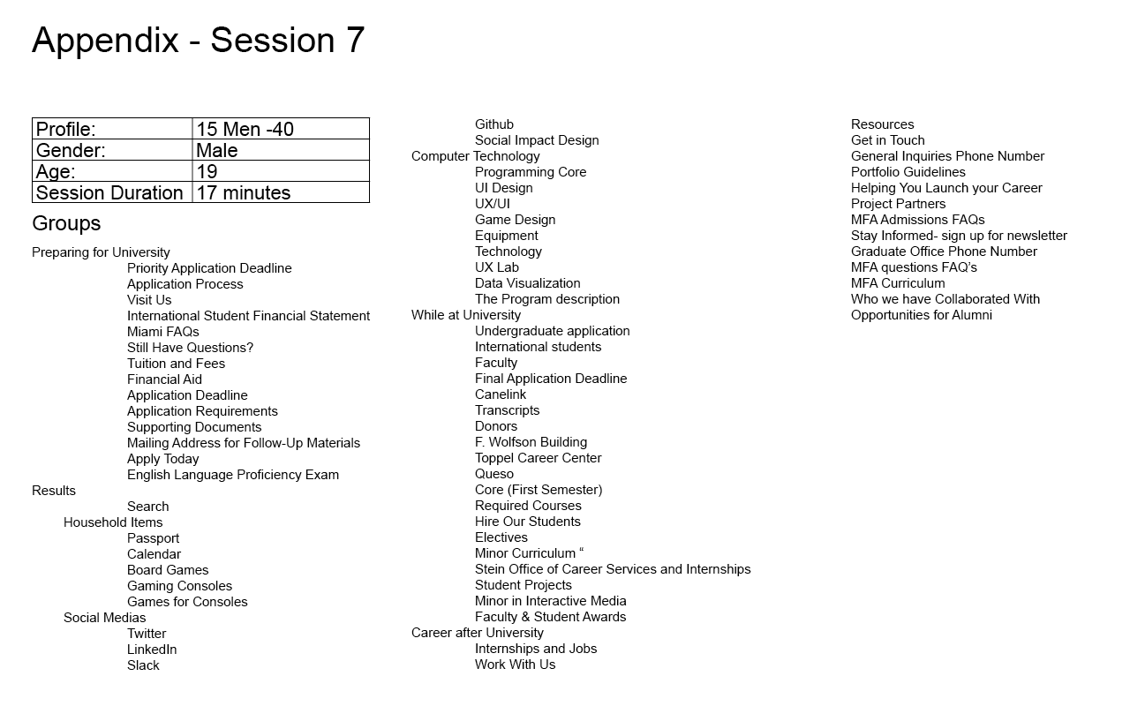

Slide 46
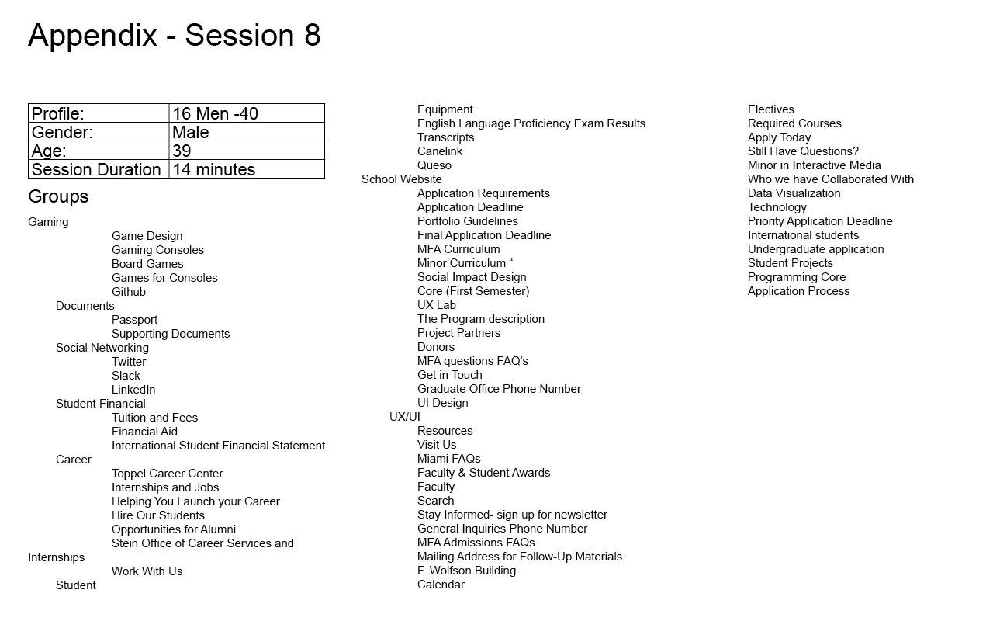

Slide 47
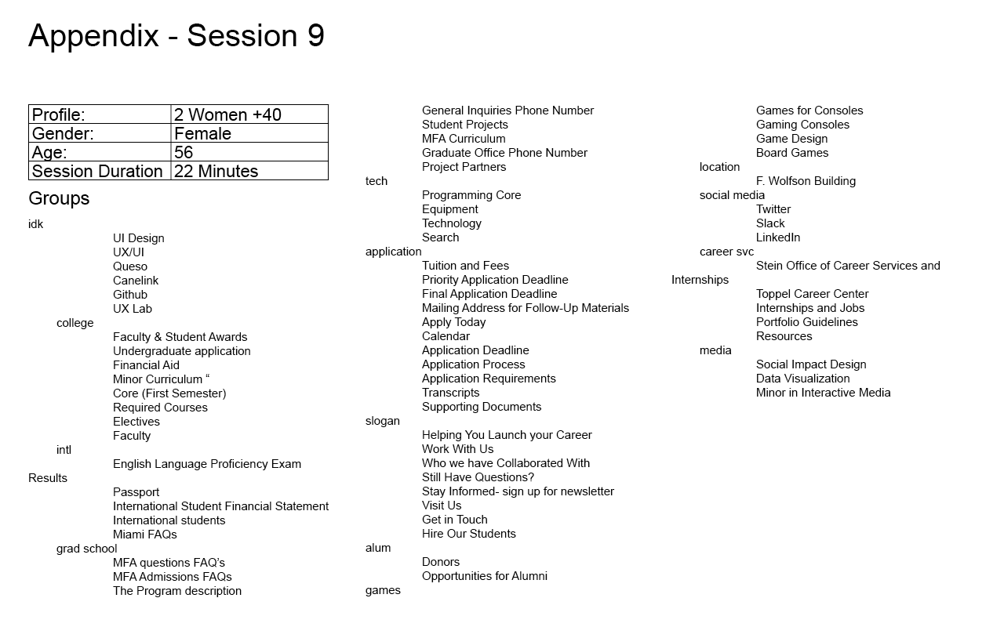

Slide 48
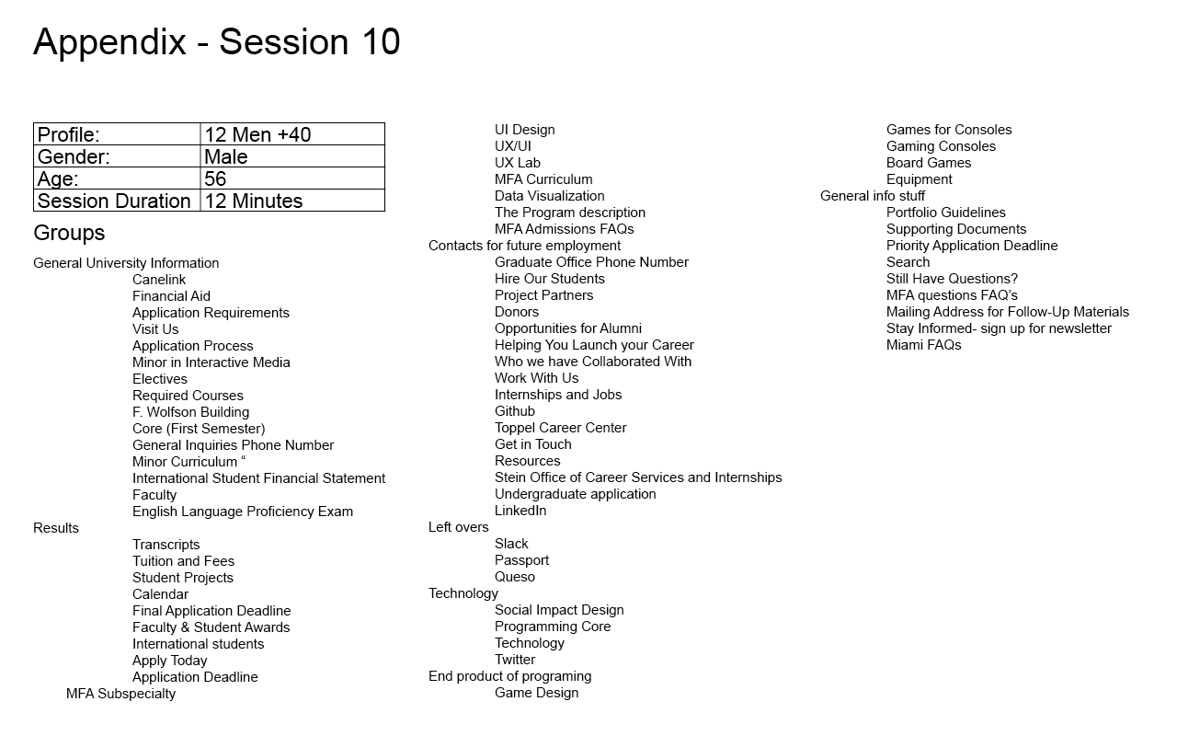

Slide 49
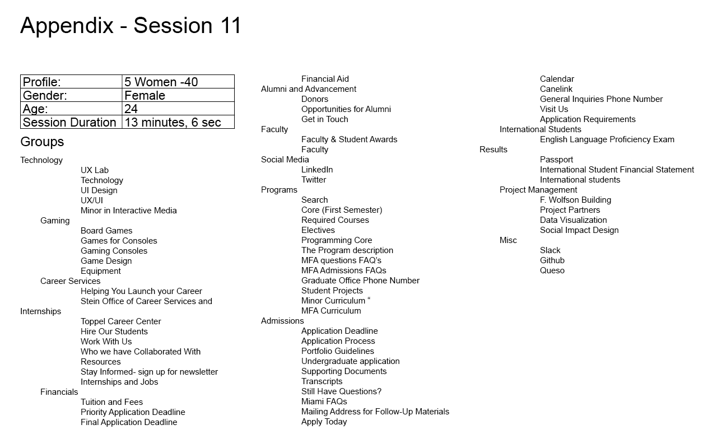

Slide 50
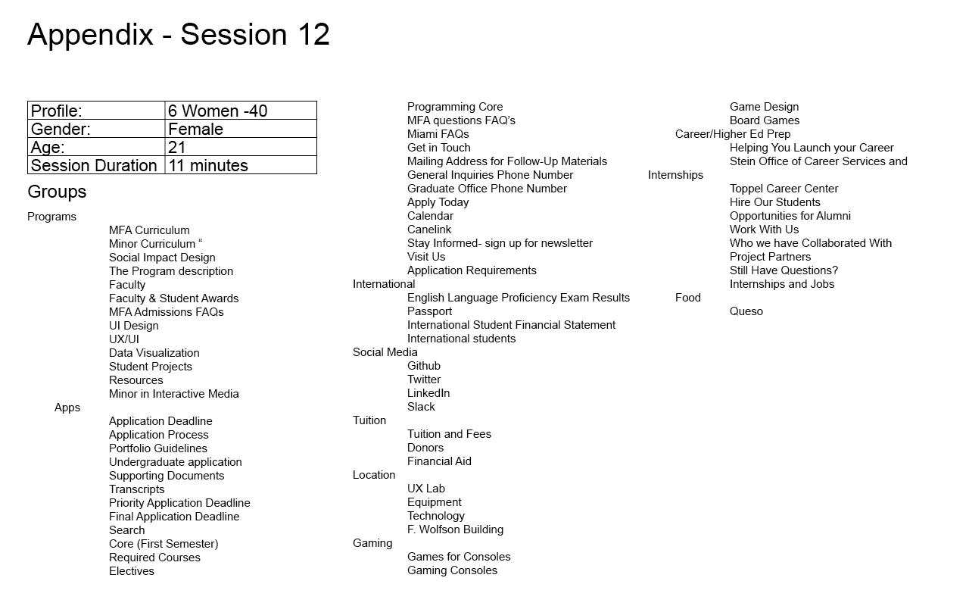

Slide 51
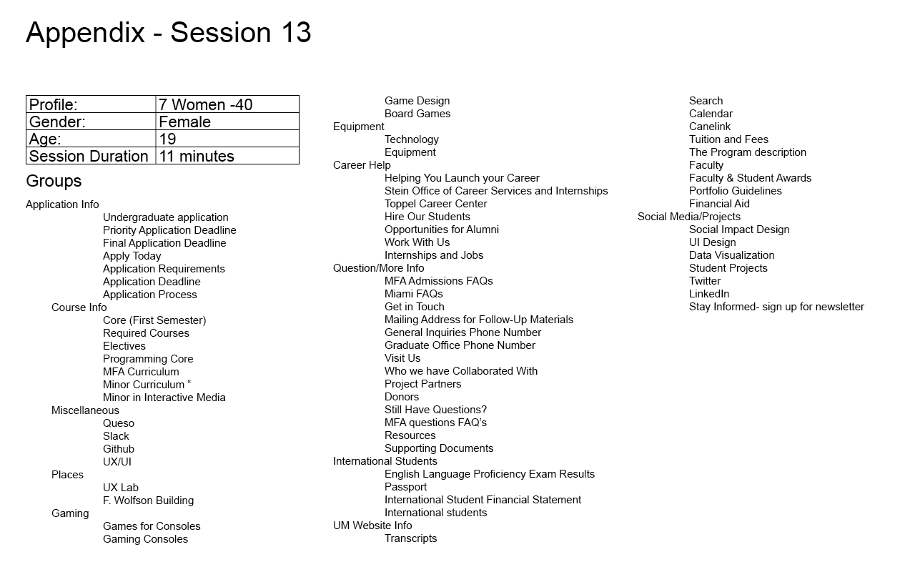

Slide 52
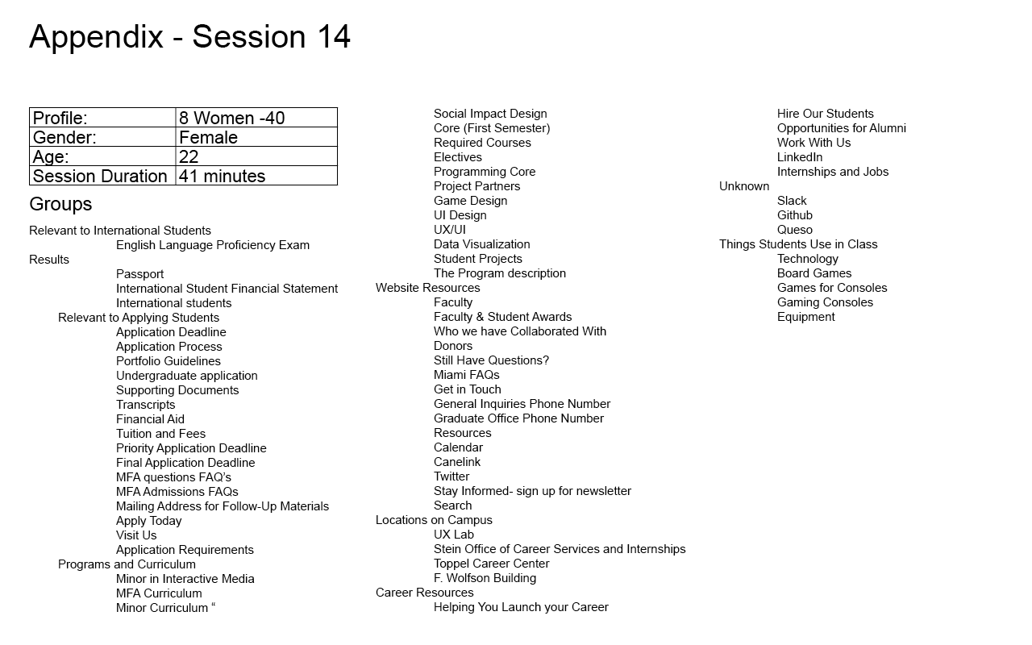

Slide 53
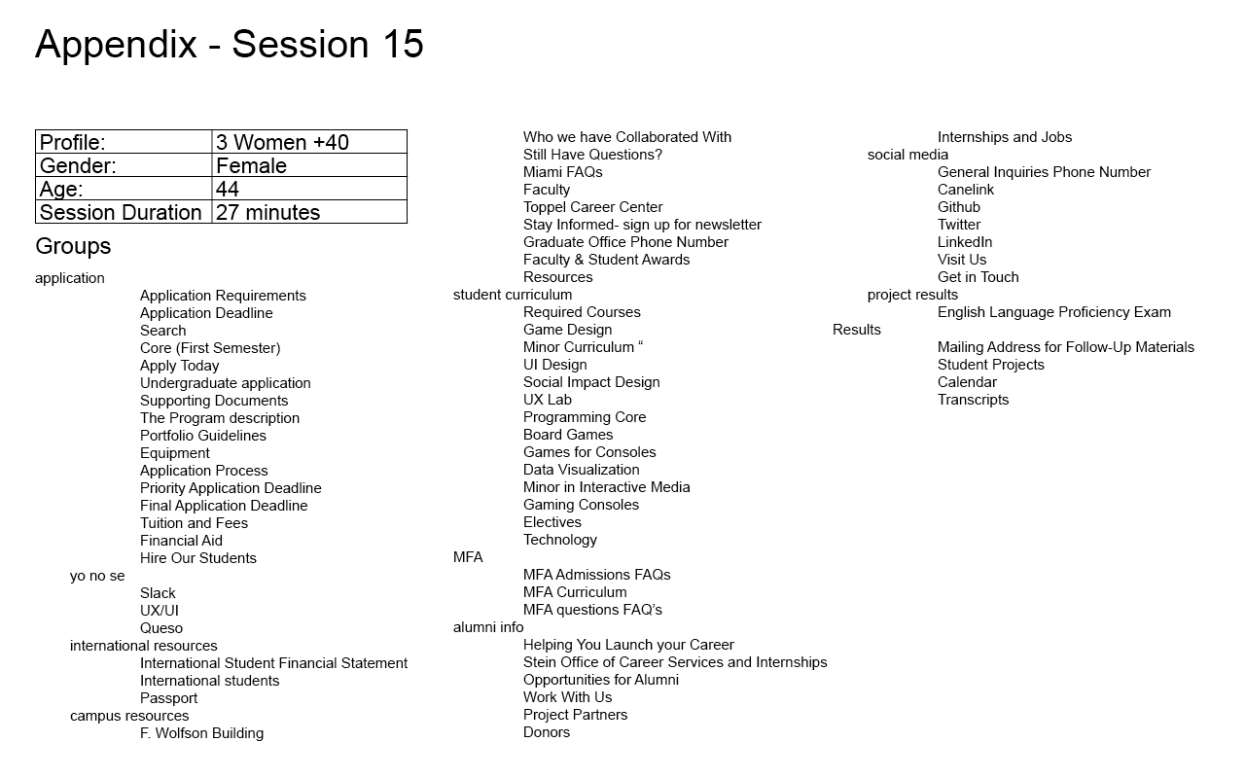

Slide 54
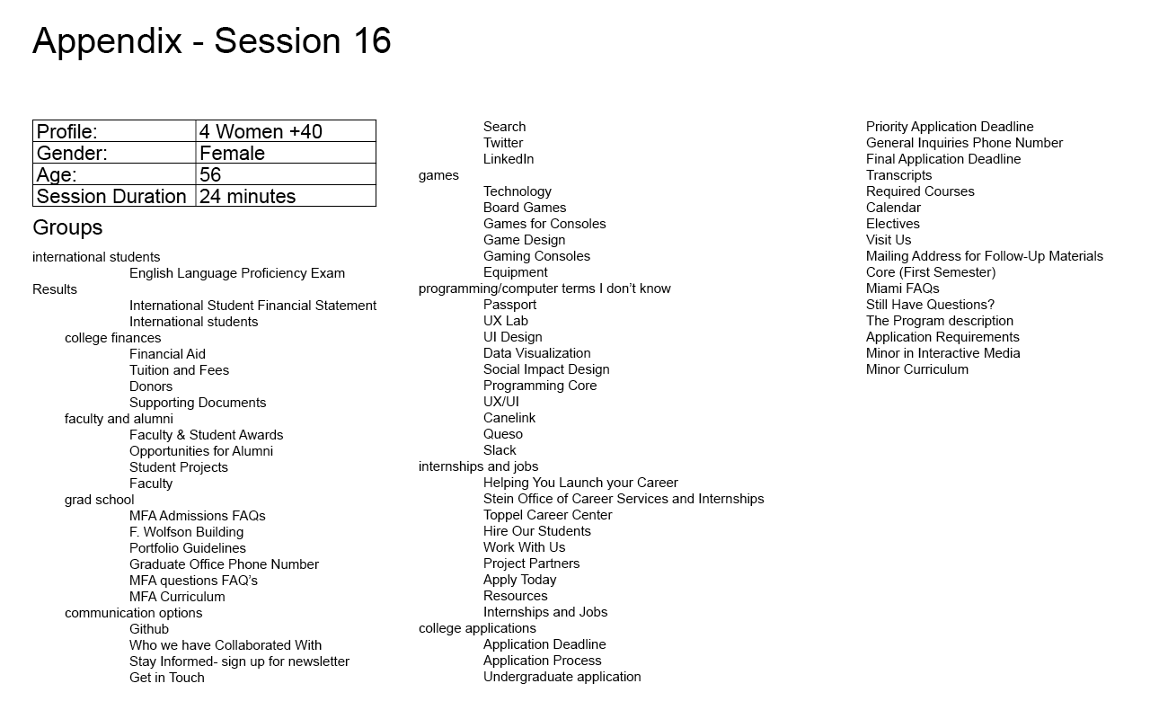

Slide 55
Appendix – Distance Matrices by Participant

Slide 56
Appendix - Distance Matrices by Partipant
1 Woman + 40

Slide 57

Appendix - Distance Matrices by Participants
2 Woman + 40

Slide 58

Appendix - Distance Matrices by Participants
3 Woman + 40

Slide 59

Appendix - Distance Matrices by Participants
4 Woman + 40

Slide 60

Appendix - Distance Matrices by Participants
1 Woman - 40

Slide 61

Appendix - Distance Matrices by Participants
2 Woman - 40

Slide 62

Appendix - Distance Matrices by Participants
3 Woman - 40

Slide 63

Appendix - Distance Matrices by Participants
4 Woman - 40

Slide 64

Appendix - Distance Matrices by Participants
1 Man + 40

Slide 65

Appendix - Distance Matrices by Participants
2 Man + 40

Slide 66

Appendix - Distance Matrices by Participants
3 Man + 40

Slide 67

Appendix - Distance Matrices by Participants
4 Man + 40

Slide 68

Appendix - Distance Matrices by Participants
1 Man - 40

Slide 69

Appendix - Distance Matrices by Participants
2 Man - 40

Slide 70

Appendix - Distance Matrices by Participants
3 Man - 40

Slide 71

Appendix - Distance Matrices by Participants
4 Man - 40

Slide 72
Appendix - Notes
Woman over 40
Time: 27 minutes
group # 1 - apply for college
then split it into two groups
“This is really confusing- they could all fall together”
“kind of like a pre-application”
“What do you want a passport for?”
“Queso? Really? Cheese?”
Portfolio guidelines
maybe this is a pre-app? don’t know what it is- resume? app portfolio?
group 3- “international” / “foreign”
passport maybe?
group 4- maybe center or school
kind of an about
resources and phone numbers
“info about the school”
stein goes with wolfson?
they’re different places, but go together because they’re places
group 5- design
don’t know what it is but it seems like a course you could take?
stay informed, visit us, newsletter?
they might all go together
MFA section
UX/UI
don't know what this is
sounds like an infection
slack goes with cheese
“unless it's something witty for something”
slack: “no idea what this is other than maybe lazy people”
group 7- “getting informed”
data vis
sounds like a class
programming
school core or maybe it's a programming class

Slide 73
Appendix - Notes
is social impact a class?
“confusing these groupings together. some do make sense together, but i'm not sure what's meant by each title of the things”
github
I guess it’s a twitter or something
“supporting documents for what???”
Hierarchy:
critical
application
important
international resources
project results
campus resources
MFA
social media
unimportant
yo no se [unknown material]
student curriculum
alumni info

Slide 74
Appendix - Notes
Woman over 40
Time: 24 minutes
started organizing in groups before reading all of the cards
grouping the “easy ones first,” obvious
trying to use groupings seen before and not trying to come up with creative or clever naming
financial aid
career
student projects
maybe apart of programs?
“don’t know what slack or github are”
“github, is that a tweeter communication thing?”
Queso “ cheese in a different language”
“Is that a hispanic computer program I don’t know? Now you’re going to say I’m prejudice”
had to guess at MFA naming
“master of fine…”
after reading data viz- “wish I understood the words”
passport is completely unrelated
name of building doesn’t mean anything to me
General Enquiry phone number
“old ladies way of LinkedIn”
“What the hell is slack”
“How did you come up with this list?”
Miami FAQ
“city or uni?”
“insufficient information”
“donors go with that financial deal”
Hierarchy:
Critical
college finances
grad school
college application
Important
internships and jobs
international students
faculty and alumni
communication options
Unimportant
programming/ computer terms I don’t know
games

Slide 75
Appendix - Notes
Male over 40
Time: 12 minutes
“I think this sucks”
First look impressions
school, design
General information
how to get things done
This all depends on the context of ordering
“I’m coming at this from an advertising educational standpoint based kind of perspective”
MFA
means media fine arts
Wolfson
“probably where you do all of this stuff”
“no idea why you have cheese in here”
slack
“you have to relax in school. Things get too tight, people need to take time off”
“It doesn’t fit well here though”
UX/UI
“That’s an advanced platform.”
What makes you say that? “I learned it from you”
No idea what github is
english test
“that’s gotta be a requirement for going to the school”
data viz
“fine arts, not a technology”
“for those not technical”
hierarchy
critical:
MFA subspecialty
Contacts for future employment
important
Technology
End of product of programming
General University Information
unimportant
Left overs
General info stuff [general information]

Slide 76
Appendix - Notes
Woman over 40
Time: 22 minutes
ui design
idk
“I’ll put everything I don’t know in an area first”
“school” grouping morphed into college
included games
canelink
idk
portfolio guidelines
unrelated to anything along with Queso
Slack
“some kind of blog thing”
supporting documents
“that’s too general”
“everything is getting a little random”
“mailing address I guess goes with the application”
“I think in big groups, not small like alumni and donors”
Slogans
group 5
started thinking of things not card sorting related
getting bored
social impact design
not familiar with the concept
“should I have made smaller groups?”
“passport is unclear”
hierarchy
critical
college
grad school
application
important
tech
career svc
intl [international]
alumni
media
unimportant
slogan
game
soc media [social media]
idk[I don’t know]
location

Slide 77
Appendix - Notes
Male under 40
Time: 12 minutes
I'm starting out by looking for similarities
Anything having to do with Admission and Applications
So all Application info stuff in one folder
Separating items so I can see what everything is
Everything regarding program, application tuition, transcripts, together.
Now I'll make another that talks about masters in fine art, we have curriculum, FAQ's, Electives, program description.
Then I'm grouping anything that has to do with technology & media
One that has to do with careers and Alumni
Making another for projects & partners
Placing into groups already made
hierarchy
Critical
Application Information
Technology and Media
Important
Alumni and Career
Program Related
International
Unimportant
Partners

Slide 78
Appendix - Notes
Canelink with Twitter because uncertain of what it its
English language proficiency results with international students
Transcript with supporting documents
Toppel career with helping launch career
Get in touch with visit us also resources
UX Ui with gamers also with Queso and Technology
hierarchy
Critical
Application & Documents
Minors/Majors Programs
Interactive Media Programs
About Us
Important
Courses
Career Services
FAQs
International Students
Unimportant
Student Work
Stay Connected
Male under 40
Time: 21 minutes
Reading names out loud
Going to put miami faq with still have questions.
Is explaining what he's doing
Going to put app deadlines together
Electives with student and fees because it sounds like a student registering
Put visit us with miami FAQ's
Application requirement with supporting document because it sounds like info on how to sign up.
Having difficulty
FAQ's with General Inquiries phone number
Cores together because they both have core.
Newsletter with General Inquiries phone number
UX lab with Game Design
LinkedIN placed with internship and jobs
Collaboration with Partners
Program description with stay informed
Games for console with Game design
MFA Curriculum with Minor Curriculum

Slide 79
Appendix - Notes
Male under 40
Time: 17 minutes
Faculty international student under University, along with canelink, these are all things that relate to Universities
Thinking about what websites have
Twitter with Linked because it's social stuff
Going to create a group for careers
Internships and jobs in it
Resources with careers you need to use
F.Wolfson with University because it's a building
Toppel also with University
Have to group items with necessities, like board games
General inquiry and Phone numbers putting with career stuff.
Going to create a technology folder
Changing to computer technology
Portfolio guidelines go under careers because people need to follow guidelines in careers?
Game Consoles with Passport group because it's things you have
Data Viz with Computer technology to see what technologies are being used
Preparing for University folder
A lot of stuff needs to be prepped before going to a University
You need supporting documents when applying so group those together
Moved Socia Impact to Social Media because of Social aspect
hierarchy
Critical
Preparing for University
Computer Technology
Important
While at the University
Career after University
Social Medias
Unimportant
Household Items

Slide 80
Appendix - Notes
Male under 40
Time: 14 minutes
*Reading out loud*
Making a file for documents - like passport , applications
A folder for general, there's a lot for this
Thinking of what websites have
I see another card for career I think I can use
International for school stuff I guess
I may be putting too much in the program category
Moving passport to it's own group
Not sure where to place github, place with LinkedIn will have to revisit
Moving Github with game stuff
Not sure where to put Donors
hierarchy
Critical
School Website
Student Financial
Documents
Important
Career
Student
Social Networking
Unimportant
Gaming

Slide 81
Appendix - Notes
Male over 50
Time: 14 minutes
FAQs seem unimportant
Not sure where to put some of these categories so I put them in “other”
Some sort of website information…?
I guess I’ll make/divide them into large categories
What is GitHub?
hierarchy
critical
application process
Important
program
career assist
resources
international students
information
unimportant
other

Slide 82
Appendix - Notes
Female over 50
Time: 14 minutes
Am I designing a web site?
Not sure where to put some of these categories so I put them in “?”
Don’t understand how these categories relate
Many of these categories seem like the same thing
There seem to be too many options
I’m making my best guesses here
hierarchy
critical
degree type
Important
apply
career path
instruction
equipment
unimportant
other stuff
? “(not sure what this stuff is)”

Slide 83
Appendix - Notes
Male over 40
Time: 9 minutes
I think the application categories are most
Not sure where to put some of these categories so I put them in “other”
Not sure if I’m doing this correctly
Some categories don’t mean anything to me
What is GitHub, Queso, Slack...?
hierarchy
critical
apply
courses
Important
MFA info
career ctr
faculty
financial aid
international
UX
unimportant
other

Slide 84
Appendix - Notes
Male over 40
Time: 11 minutes
I feel like I’m playing a game
There are lots of choices I don’t understand how they relate to one another
Is this a web site?
Looks like a school/university application site
Too many categories that seem unrelated
I know what Twitter, LinkedIn is, but some of these of these others don’t make sense
I’m just making big buckets
hierarchy
critical
application process
major/minor information
Important
program description
faculty
job opportunities
resources

Slide 85
Appendix - Notes
Female under 40
Session Duration: 11 minutes
I want to look at all the cards first before I start putting them into categories
I see several things that apply to international students, I am going to put passport in there too because that fits with the international category
There are many things that pertain to financial information. When I see priority application deadline I think of the FAFSA.
A bunch of these are career related, there are many things that fall under the idea of career services
I have no idea what Slack and Queso are, I am going to just create a Misc. category for these things
Critical:
Programs
Admissions
International Students
Important:
Career Services
Financials
Alumni and Advancement
Faculty
Project Management
Unimportant:
Social Media
Technology
Gaming
Misc

Slide 86
Appendix - Notes
Female Under 40
Session Duration: 11.5 minutes
Made a group of things that all appeared to be application things - it looks like there is some kind of application process, there are things that you need would need for to apply for something
I see course titles, I want to call it curriculum because they are related to courses and programs
I think things like social impact design, UI/UX seem like courses
There are a bunch of things that fall under career resources
FAQs are a goal oriented thing, like part of an application process
Calendar is for planning so that makes sense with the application process
“What is Queso? That’s cheese right? I am going to make a food category”
What is Queso, I guess I am making a food category
Critical:
Apps
Programs
Career/Higher Ed Prep
International
Important:
Social Media
Tuition
Location
Unimportant:
Gaming
Food

Slide 87
Appendix - Notes
Female Under 40
Session Duration: 11 Minutes
Application is the first broad category that I can see, so I am going to group things together that look like they would go under application information
A lot of these things are on the University of Miami website so I am going to group those things together.
There are a couple of cards that I recognize that are buildings on campus.
Equipment and technology are similar things so I am going to put them together and give it the category title, Equipment.
There are several things that relate to career help and resources
The FAQs are question related, so I would put them together
Social media and projects I would say are related, they are current event type things
Critical:
UM Website Info
Important:
Application Info
Course Info
Career Help
Question/More Info
International Students
Social Media/Projects
Unimportant:
Miscellaneous
Places
Gaming
Equipment

Slide 88
Appendix - Notes
Female Under 40
Session Duration: 41 Minutes
Don’t want to group them until I know what they all are.
If I make broad categories, I don’t have to think too much about it
I want to put things in multiple categories, this is so stressful
Equipment is so vague - what is it? It means nothing to me. What do you do even do with that - technology?
I am not sure about these cards I have left, maybe entertainment, although the rest are all school related, so maybe I’ll go with things students use on class.
Critical:
Relevant to International Students
Relevant to Applying Students
Important:
Programs and Curriculum
Website Resources
Career Resources
Unimportant:
Locations on Campus
Unknown
Things Students Use in Class

